Slide 1
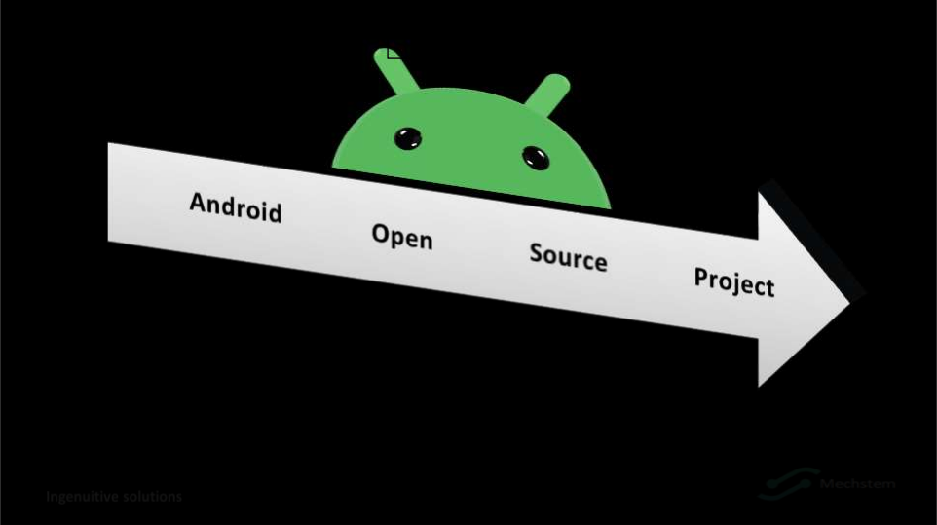
AOSP

Slide 2
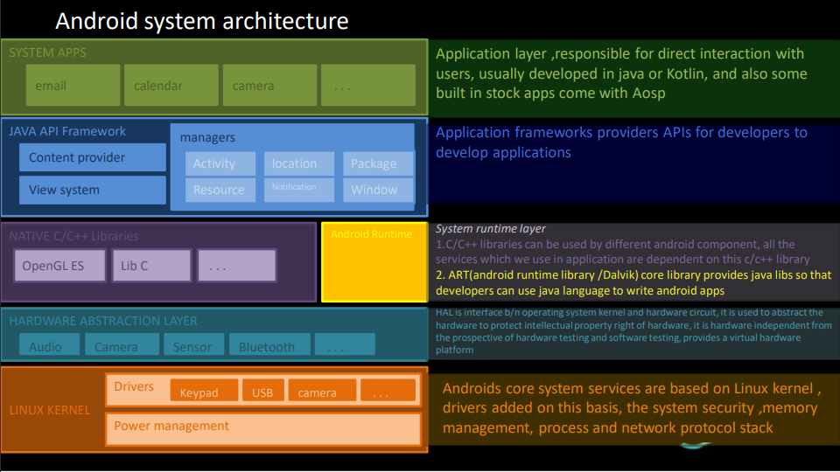
system

Slide 3
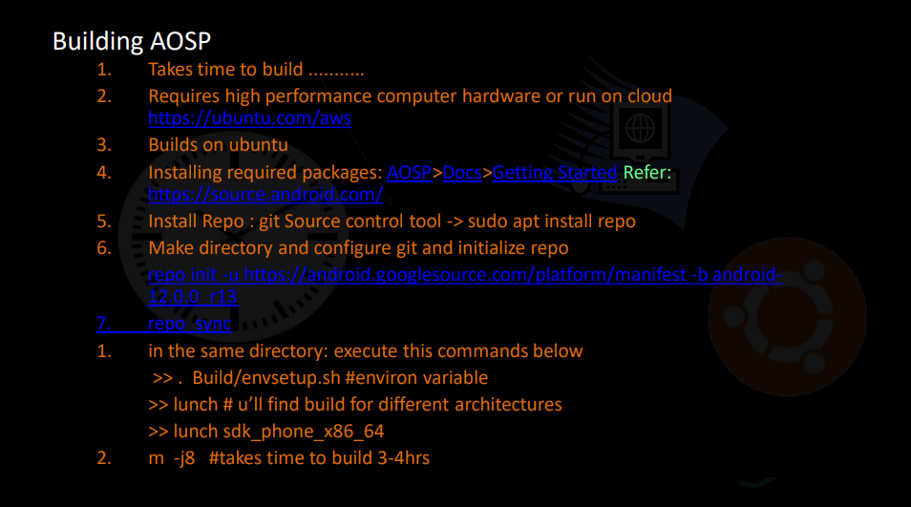
Building AOSP

Slide 5
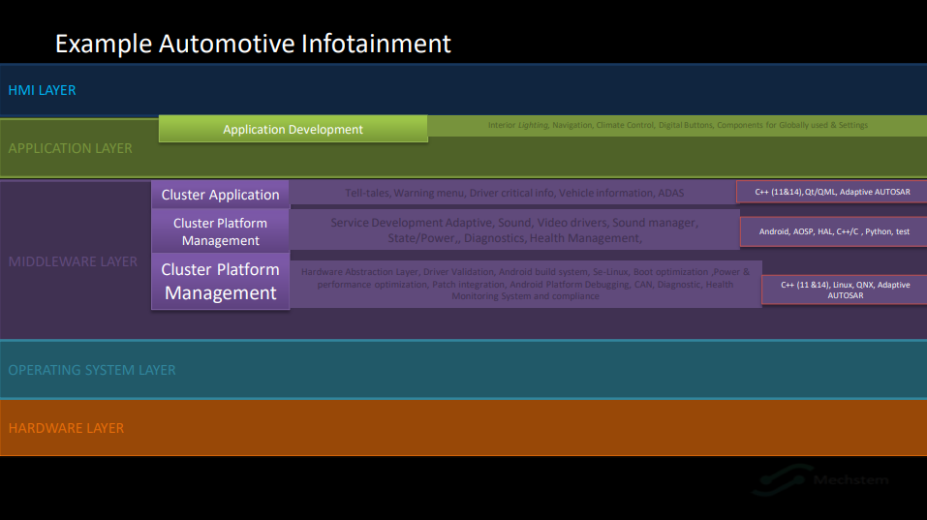
Automotive cockpit display

Slide 6
Team
Infotainment digital cockpit
SW ARCHITECT | LEAD/SCRUM MASTER | HMI LEAD | SENIOR SW DEVELOPER
System architecting ,design and development of in vehicle infotainment ,telemetric, Digital cockpit, HMI, Driver information systems Connected car, point of sales, terminal(contact/contactless smart card). | Design and development of automotive infotainment and connectivity features AUTOSAR ,Functional safety and ADAS platforms, applications on embedded Linux platform yocto build, open source stacks, remote UI | Programming and debugging skills In C++ using OOAD and UML concepts for automotive HMI Qt/QML based HMI development Concepts and design of HMI elements using UML | Software development (QNX and Linux operating system). Infotainment platforms applications and middleware components. Image decoder ,services ,wifi services application and middleware's for Linux based platforms.
CLOUD ENGINEER | TEST LEAD | SENIOR IOS DEVELOPER | SENIOR ANDROID DEVELOPER
Design and develop cloud based applications Managing cloud environments and deploying and debugging cloud initiatives Extensive knowledge of APIs to design Restful services, and integrate them with existing data providers, using JSON or XML | Testing of IVI features Testing of connected cloud applications Scripting and automation Testing of automotive communication protocols(CAN,LIN,ethernet ,etc) | Design and develop IOS mobile apps Experience of developing HTML,Hybrid,Native apps Usability testing,security assesment,app store deployment | Design and development of android app Experience of developing HTML5

Slide 7
Architecture cluster
Display1 ivi display2 display4(cluster)
HMI (Qt/QML)
HMI APP
APP layer/Bussiness logic
IVI
HUD
CLUSTER
Middleware layer
Multimedia components
Connectivity framework
Speedo algorithm driver
SOME-IP Services
Connectivity(USB BT)
Driver assistant manager
IPC Manager
Media server manager
Security manager
AVB Services
TellTale Manager
Vehicle interface (CAN,eAVB)
FOTA,cloud services
Navigation
HUD Manager
Embedded Linux RTOS(ASIL-B)
SOC
2x ARM cortex A15
IPU1 dual cortex M4
IPU2 dual cortex M4
SDIO Ethernet UART
CANFD
Wifi module ADAS controller 5G/LTE MODEM(Hotspot)
HUD Controller

Slide 8
HW platform components
Sl No | Item | Qty
1 | TI Jacinto6 plus 705852-1001(Board) | 1
2 | FPD link display ,resolution 1280x800(IVI display) | 1
3 | Win sonic stretch LCD display ,CH,s12,3”-1920x720(cluster display) | 1
4 | WIN Link 8 module 2.4GHz Wi-Fi +Bluetooth COM8 evaluation module | 1
5 | Mouser part no. 490-sdi65-12-ud-ps(charger) | 1
6 | Pioneer amplifier GM-D8704 | 1
7 | SD-Cards and SD Card Extension Cable | 2
8 | USB Hub | 2
9 | HDMI cable | 2
10 | USB BT Dongle | 2
11 | 3.5mm to 2 male RCA Adapter cable 4 feet | 1
12 | SIM Card | 2
13 | Quectel modem and Evb kit(wifi module/AF20 Ethernet)

Slide 9
Checklist
4 | infotainment display | Radio
 |  | Bluetooth(A2DP,HFP)
 |  | BT Audio Multicasting
 |  | wifi media streaming(RSE)
 |  | Ethernet AVB
 |  | media player USB
 |  | personal assistance(calender and themes)
 |  | Camera integration
 |  | gesture control
 |  | settings (IVI, vehicle control)
1 | HMI | QT/QML based HMI
 |  | MVC based Architecture
 |  | interface HMI with CAN
 |  | interface HMI with IPC like DBUS
 |  | Touch based input controls
 |  | enhanced user experience(Graphics,animation,media)
 |  | Multi HMI Themes supported
 |  | cross platform HMI support
 |  | Pop ups and warnings
 |  | Startup and farewell screen
5 | Digital instrument cluster | Speed
 |  | RPM
 |  | Total KM/mile
 |  | Time & date
 |  | gear info(PRDN)
 |  | mode(Eco/sport/ power saver)
 |  | telltales
 |  | warningns(door lock , seatbelt ,lane change)
 |  | tripcomputer details
 |  | distance
 |  | EV:state of change
 |  | EV:state of health
 |  | EV:Pack current
 |  | EV:pack temperature
 |  | EV:battery charging
 |  | EV:performance feedback
 |  | EV: battery saver mode
2 | IOT integration | MQTT
3 | connected Car | Cloud connectivity
 |  | IOT HUB device intigration(IOT edgeruntime)
 |  | Virtual voice assistance (Alexa auto intigration)
 |  | SW upgrade USB

Slide 10
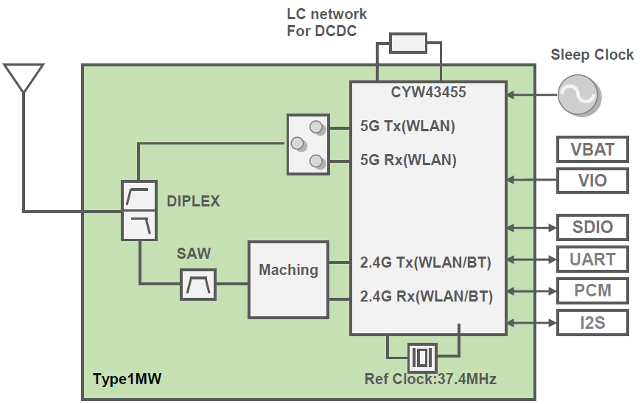
BT, Wi-Fi SDD
Introduction
Scope and Overview
This document gives the design details and integration of Wi-Fi and BT module LBEE5HY1MW-230 with i.MX 8M Mini.
Brief about Wi-Fi+BT combo IC LBEE5HY1MW-230
Cypress CYW43455 inside
Compliant with IEEE802.11a/b/g/n/ac
Compliant with Bluetooth specification v5.0
SAW filter inside
SDIO interface for W-LAN
Interface support for Bluetooth is Host Controller Interface (HCI)
Block diagram of LBEE5HY1MW

Slide 11
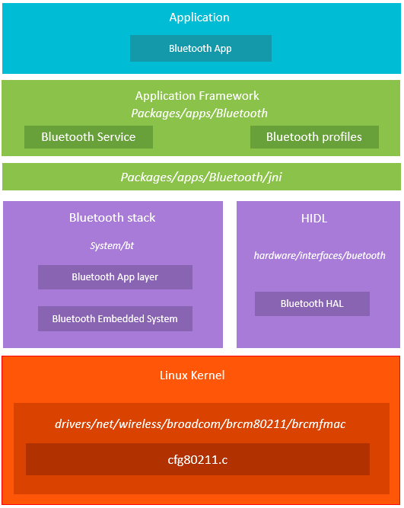
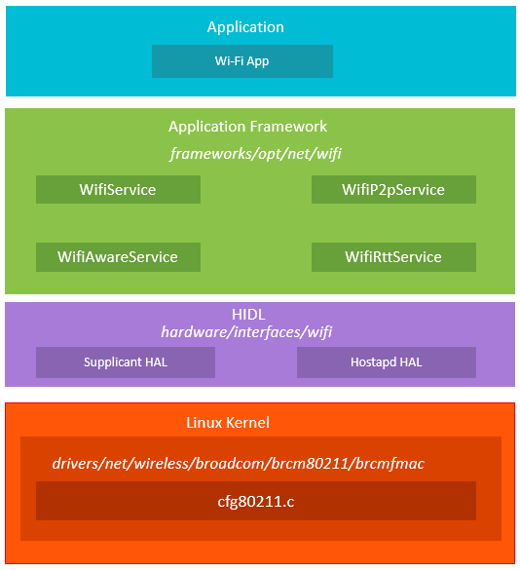
BT, Wi-Fi SDD
System Architecture
1. Bluetooth Architecture
2. Wi-Fi Android Architecture

Slide 12

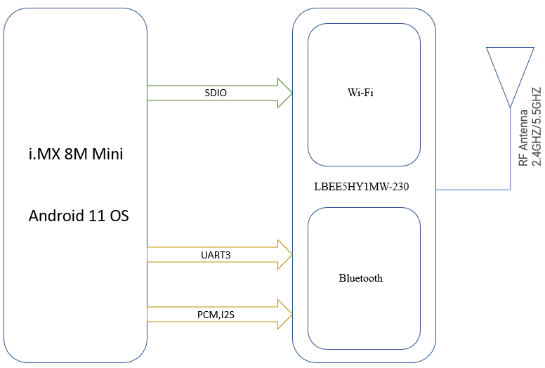
BT, Wi-Fi SDD
Block Diagrams/Context Diagrams
Below block diagram gives details about overall design at concept level i.e., treating modules as blocks and clearly mentioning their interfaces
The Wi-Fi+BT IC LBEE5HY1MW-230 is connected with i.MX 8M Mini through SDIO, UART, PCM and I2S interfaces and where SDIO interface is used to achieve Wi-Fi functionality. UART, PCM and I2S are used for Bluetooth functionality.
The Wi-Fi+BT module is connected with RF antenna as shown in the above block diagram.
Software Platform/Tools/Environment
→Software platform
NXP Android 11 operating system which is downloaded from below mentioned link and compiled. (https://www.nxp.com/webapp/Download?colCode=11.0.0_2.2.0_ANDROID_SOURCE&appType=license)
→Tools
Arm cross compiler, clang, UUU, adb, fastboot. Git.
Development environment
MX8M Mini with Wi-Fi+BT
Test environment
Monitor/Display IMX-MIPI_HDMI board
HDMI
Design
Directory /File Structure
<My_Android>/vendor/nxp-opensource/kernel_imx/
→arch/arm64/configs/imx_v8_android_defconfig
→arch/arm64/boot/dts/freescale/imx8mm-evk.dtsi
→drivers/net/wireless/broadcom/brcm80211/brcmfmac/Kconfig
→drivers/net/wireless/broadcom/brcm80211/brcmfmac/Makefile
→drivers/net/wireless/broadcom/brcm80211/brcmfmac/ cfg80211.c

Slide 13
BT, Wi-Fi SDD
Device tree changes
Below are the tentative device tree changes which will be used for Wi-Fi+BT bring-up.
+// SPDX-License-Identifier: (GPL-2.0+ OR MIT)
+/*
+ * Copyright 2021 Kimball
+ */
+/ {
+ cyw_wlan_pwrseq: cyw_sdio-pwrseq {
+ compatible = "mmc-pwrseq-simple";
+ pinctrl-names = "default";
+ pinctrl-0 = <&pinctrl_cyw_wlan>;
+ reset-gpios = <&gpio5 11 GPIO_ACTIVE_LOW>; /* WL_REG_ON */
+ };
+ cyw_bt_reset: cyw_bt_reset{
+ compatible = "gpio-reset";
+ pinctrl-names = "default";
+ pinctrl-0 = <&pinctrl_cyw_bt>;
+ reset-gpios = <&gpio5 12 GPIO_ACTIVE_LOW>; /* BT_REG_ON */
+ reset-delay-us = <150000>;
+ /*reset-post-delay-ms = <40>; */
+ #reset-cells = <0>;
+ };
+};
+
+&iomuxc {
+ pinctrl_cyw_wlan: cyw_wlangrp {
+ fsl,pins = <
+ MX8MM_IOMUXC_ECSPI2_MOSI_GPIO5_IO11 0x19 /* WL_REG_ON */
+ MX8MM_IOMUXC_ECSPI2_SCLK_GPIO5_IO10 0x19 /* WL_HOST_WAKEirq */
+ >;
+ };
+ pinctrl_cyw_bt: cyw_btgrp {
+ fsl,pins = <
+ MX8MM_IOMUXC_ECSPI2_MISO_GPIO5_IO12 0x19 /* BT_REG_ON */
+ MX8MM_IOMUXC_ECSPI2_SS0_GPIO5_IO13 0x19 /*BT_HOST_WAKEirq */
+ >;
+ };
+};
+
+&usdhc2 {
+ mmc-pwrseq = <&cyw_wlan_pwrseq>;
+ no-1-8-v;
+ non-removable;
+ pm-ignore-notify;
+ keep-power-in-suspend;
+ status = "okay";
+
+ cyw43455: brcmf@1 {
+ reg = <1>;
+ compatible = "brcm,bcm4329-fmac";
+ interrupt-parent = <&gpio5>;
+ interrupts = <10 IRQ_TYPE_LEVEL_LOW>;
+ interrupt-names = "host-wake";
+ };
+};
+
+/* BT */
+&uart3 {
+ resets = <&cyw_bt_reset>;
+};

Slide 14
BT, Wi-Fi SDD
Driver file for Wi-Fi + BT
The required driver file to the Wi-Fi and Bluetooth functionality is available in NXP A11 codebase at below mentioned path.
Path:
<my_android>/vendor/nxp-opensource/kernel_imx/drivers/net/wireless/broadcom/brcm80211/brcmfmac/cfg80211.c
BoardConfig.mk file changes
In the device/nxp/imx8m/evk_8mm/Boardconfig.mk add the below code snippet
# Broadcom BCM43455 WIFI
BOARD_WLAN_DEVICE := bcmdhd
WIFI_DRIVER_FW_PATH_PARAM := "/sys/module/brcmfmac/parameters/alternative_fw_path"
BOARD_VENDOR_KERNEL_MODULES += \
$(KERNEL_OUT)/drivers/net/wireless/broadcom/brcm80211/brcmfmac/brcmfmac.ko \
$(KERNEL_OUT)/drivers/net/wireless/broadcom/brcm80211/brcmutil/brcmutil.ko
# Broadcom BCM43455 BT
BOARD_BLUETOOTH_BDROID_BUILDCFG_INCLUDE_DIR := $(IMX_DEVICE_PATH)/bluetooth
BOARD_HAVE_BLUETOOTH_BCM := true
Mount Wi-Fi Module
Add the below code snippet to device/nxp/imx8m/evk_8mm/early.init.cfg insert Wi-Fi module built dynamically.
insmod vendor/lib/modules/brcmutil.ko
insmod vendor/lib/modules/brcmfmac.ko

Slide 15
Device.mk file changes
Add the below code snippet to device/nxp/imx8m/evk_8mm/evk_8mm.mk to update the Wi-Fi+BT IC module firmware.
# WiFi HAL
PRODUCT_PACKAGES += \
wificondi \
wifilogd
# Broadcom Bluetooth
PRODUCT_PACKAGES += \
libbt-vendor-broadcom
# BCM WiFi Firmware CYW43455
PRODUCT_COPY_FILES += \
$(IMX_FIRMWARE_PATH)/imx-firmware/cyw-wifi-bt/1MW_CYW43455/brcmfmac43455- sdio.bin:vendor/firmware/brcm/brcmfmac43455-sdio.bin \
$(IMX_FIRMWARE_PATH)/imx-firmware/cyw-wifi-bt/1MW_CYW43455/brcmfmac43455- sdio.clm_blob:vendor/firmware/brcm/brcmfmac43455-sdio.clm_blob \
$(IMX_FIRMWARE_PATH)/imx-firmware/cyw-wifi-bt/1MW_CYW43455/brcmfmac43455- sdio.txt:vendor/firmware/brcm/brcmfmac43455-sdio.txt \
$(IMX_FIRMWARE_PATH)/imx-firmware/cyw-wifi-bt/1MW_CYW43455/BCM4345C0.1MW.hcd:vendor/firmware/brcm/BCM4345C0.1MW.hcd
Update Bluetooth interface
Add below code snippet to device/nxp/imx8m/evk_8mm/ueventd.nxp.rc to update the BT interface.
/dev/ttymxc2 0660 bluetoothbluetooth
Build Mechanism
Add the Makefile entry in the Makefile as shown below.
Path:
<my_android>/vendor/nxp-opensource/kernel_imx/drivers/net/wireless/broadcom/brcm80211/ brcmfmac/Makefile
obj-$(CONFIG_BRCMFMAC) += brcmfmac.o cfg80211.o
Add the Kconfig entry
Path:
<my_android>/vendor/nxp-opensource/kernel_imx/drivers/net/wireless/broadcom/brcm80211/brcmfmac/ Kconfig
config BRCMFMAC
tristate "Broadcom FullMAC WLAN driver"
depends on CFG80211
select BRCMUTIL
help
This module adds support for wireless adapters based on Broadcom FullMAC chipsets. It has to work with at least one of the bus interface support. If you choose to build a module, it'll be called brcmfmac.ko.

Slide 16
Add defconfigentry
Path: <my_android>/vendor/nxp-opensource/Kernel_imx/arch/arm64/configs/imx_v8_android_defconfig
CONFIG_BRCMFMAC=m
Build the kernel with below commands
$ cd {MY_ANDROID}
$ source build/envsetup.sh $ lunch evk_8mm-userdebug $ export AARCH64_GCC_CROSS_COMPILE=/home/homdir/NXPNew/gcc_toolchain/gcc-arm-8.3-2019.03-x86_64-aarch64-linux-gnu/bin/aarch64-linux-gnu- $ ./imx-make.sh kernel -j2 2>&1 | tee build-logs/build-log_$(date '+%Y%m%d_%H%M%S').txt
After build got success, Find the below path for generated brcmfmac.ko
out/target/product/evk_8mm/obj/KERNEL_OBJ/drivers/net/wireless/broadcom/brcm80211/brcmfmac/brcmfmac.ko
Coding Standards
1. Programming Language used
C, C++
2. Coding Standards Adopted
Coding guidelines
Reference
https://www.nxp.com/products/processors-and-microcontrollers/arm-processors/i-mx-applications-processors/i-mx-8-processors/i-mx-8m-mini-arm-cortex-a53-cortex-m4-audio-voice-video:i.MX8MMINI
https://www.murata.com/en-sg/products/connectivitymodule/wi-fi-bluetooth/overview/lineup/type1mw
Glossary
Wi-Fi – Wireless Fidelity
BT – Bluetooth
HDMI – High-Definition Multimedia Interface
MIPI - Mobile Industry Processor Interface
UUU - Universal Update Utility
ADB – Android Debug Bridge
IC – Integrated Chip
I2C – Inter-Integrated Circuit

Slide 17
Android Auto
Teams
Audio,Video,input,BT,Wifi team
Working along with
Architect
Interacting with
HMI(Projection and connection manager)
Interacting with
Development team
Feature Testing
Unit testing
Certification manager
Interacting with
Interacting with
Precertification team
Entire test suite to comply with goggle expectation
Feature Owners
System Testing team
Complete HU test (HW/SW)

Slide 18
Android Auto
Inputs
How AAP wrapper developed
How GAL is implemented ,which ever component you will be assigned and which component sitting where and what is the interaction b/n them
Architecture doc
HUIG(Head unit integration guide)
While implementing if you face any issues to understand requirements you need to refer HUIG and GAL
(HUIG will tell you exact requirement like Bluetooth should call wifi if the wifi connection is failed)
GAL reference doc
GAL will tell ,What kind of properties you need to use ,reference need to use ,and what kind of interfaces to use, to talk to phone device
HUCD(certification)

Slide 19
Android Auto
Info(software is built for):
make : OEM/After market
model: variant of vehicle(suzuki swift, then no other variant can be used )
year :2026(other year this software cannot be used)
HU make: (given by tier1 supplier)
HU model:
HU software build: (version verified by Google)
HU software version (utilized for this model)
vehicle identifier :
Read by Vehicle property class through car services if your writing Application software, if your writing middleware youll be relying on AIDL or HAL Layer

Slide 20
Android Auto
AUTHENTICATION PROCESS
User
HU
MD
OEM
Connect MD to HU
Register Brand Name
SSL key request
Register logo
Version Request(AOAP ver.)
Google
Version Response
HU Certificate and SSL handshake(Key supported or not)
MD Certificate and SSL handshake
SSL Authentication is success
AAP Communication

Slide 21
Android Auto
AUTHENTICATION PROCESS
In case communication failed some error codes defined by Google that error code, in cases certificate keys or invalid (HU has invalid keys) developers can proceed writing code but not able to test code , if u see authentication problem need to check SSL keys are flashed in HU , in this case need to connect with person responsible.

Slide 22
Android Auto
Wireless communication
5Ghz band – 802.11ac(wifi should support)
2.4Ghz - AAP is not supported
Communication this way
HU
MD
GAL Receivers
Car Service
Base Layer of AAP
SSL
SSL
Auth
TCP(WIFI AP)
TCP(WIFI STA)
WIFI
RFCOMM Server
RFCOMM Client
BT

Slide 23
Android Auto
Wireless communication
HU will connect to MD ,HU made discoverable , HU make BT adapter discoverable
It’s like Bluetooth speaker from the mobile device u’ll search for to connect.
We will be basically send UUID (establish connection to MD),
Mobile device will try connect to RFCOMM Endpoint ,coz HU now in the discoverable mode
Basically MD will connect to RFCOMM HU, lower layer communication i.e, over RF.
Once done ,HU connection is successful, pairing is done
Once its done, Wifi version request will be sent from HU ,basically sent to understand each others wifi capabilities.
MD will send a wifi response.
Once wifi capabilities are known BT is disconnected ,since wifi is not connected yet still in negotiation.
Wifi start Request until this point its Bluetooth communication next
Attempt to connect to wifi, possible error could be that MD not able to connect.(itll be standard errors )
Another trail to attempt to connect can be done
HU(BT)
HU(WIFI)
MD
Bluetooth connection (Unique universal id)
Connect to RFCOMM Endpoint
BT connection is successful
Wifi Version Request
Wifi Version Response
Wifi Start request
Attempt to connect to Wifi
Connection Error
Continued...

Slide 24
Android Auto
Wireless communication
In an another attempt Wifi info Request sent
as from the diagram sequence is followed till wifi connection status is success further wifi gets connected and wifi communication is continued.
After this , definite port is provided by head unit for TCP connection
On this particular port HU and BT talking with each other to share the AOAP based communication.
After this, established communication is completely over WIFI (TCP)
Once TCP Is established rest of communication will happen over the GAL protocol , be it a Video set up request, Audio setup request or metadata shared over TCP protocol ie, over WIFI itself
Note: SSL (Authentication process )done after WIFI connection
HU(BT)
HU(WIFI)
MD
Wifi info Request
Wifi info response
BT connection is successful
Attempt connect to wifi
Connection is success
Wifi connection status (till here BT communication is done after this BT is stopped)
TCP Connection (PORT)
What is TCP connection, reading timeout , buffer size, what kind of socket being ??
GAL interface

Slide 25
Android Auto
Video (Android Auto projection video)
Note:
TOOLS : GAL Monitor logs application in mobile device to calculate latency.
Video streaming data is connected to video decoding chain (video pipeline connected to channel)
Video(mirroring)
1.Setup Latency(MD sharing video through AOAP to HU)
→ 500ms
→video decoding chain should be established , as soon as AAP
request from HU is done handshaking is done, until video is ready.
2.Output Latency(Time to receive the video)
→50ms
→frame should be ready, until rendered on display ,
3. Frame Rate:
→30/60hz
→ touch latency (As soon as user touches some of the UI elements , refer: Figure)
User
HU
MD
Touch UI
Touch latency < 50ms
App response
AAP Projection request
h.264 video streaming
Decoder latency < 50ms
(video decoding chain)

Slide 26
Android Auto
Audio
Note: (GAL 1.6 ) version
3 different components ,
1.Audio source→ logical endpoint from where data is generated(audio from map, audio from phone, from music)
2. Audio sink→ Receiver from the source
3.Audio stream : combined name for source and sink, source from generated sink it is mashed up(call services, notification)(expectation from Google is that you need to support AAC-LC and PCM (without this codec's audio wont support))
16khz/48khz→(GAL Receiver)
From protocol document get from audio gain, useful during debugging , need to check for response gain,

Slide 27
Android Auto
Audio
Note: (GAL 1.6 ) version
User
HU
MD
Music play request
Audio focus request gain(request for audio channel),(head unit should stop what it is playing and keep it ready to decode ,its main channel)
Audio focus request STATE_GAIN
Audio stream start

Slide 28
Head unit integration guide (1.3.0)
Android Auto
Android Auto ( www.android.com/auto ) enables seamless integration between mobile devices and vehicles, allowing drivers to access and control technology on mobile devices using an interface that’s easier and safer to use while driving
This document describes the integration that enables automotive in-vehicle infotainment (IVI) systems to leverage the compute power, connectivity, and applications of modern mobile devices through Android Auto Projection (AAP) technology
It is intended for automotive infotainment engineering development teams who want to integrate AAP on a head unit.
It does not describe the low-level AAP protocol implementation abstracted by a sender and receiver library on both the head unit (HU) and the mobile device (MD). For details, refer to the AAP receiver library documentation
About Android Auto Projection (AAP)
AAP bridges mobile devices and vehicles to enable drivers to access the capabilities of the device through the physical human machine interface (HMI) controls provided by the vehicle.
The mobile device manages all user interface (UI), software logic, connectivity, and compute power for applications, and projects these applications into the vehicle through AAP.
AAP architecture leverages the strongest attributes of both vehicle and mobile device to create.
From the vehicle , the Android Auto integration leverages: an optimal driving experience.
Human machine interface (HMI) better suited for use while driving
Highly accurate vehicle data with better information about the driving environment

Slide 29
Head unit integration guide (1.3.0)
Android Auto
From the mobile device , the Android Auto integration leverages:
Latest computing hardware platform
Latest software platform
Latest high speed data connectivity to the cloud via latest mobile data networks
Evolution of hardware, software, and connectivity at consumer electronics pace
Channels
The platform implementation supports USB 2.0, but the protocol itself is transport-agnostic and runs over any transport with sufficient bandwidth (future implementations may utilize Wi-Fi Direct). The AAP protocol includes separate channels to manage data streams between mobile device and vehicle:
Control (bi-directional) . Manages link initialization and setup of channels for media, input, etc.
Video Output (device-to-vehicle) . Sends H.264 video from the mobile device to the vehicle for display on the main console display.
Audio Output (device-to-vehicle) . Carries audio from the mobile device to the vehicle for output through the vehicle speakers (AAC with 48k, AAC or PCM for 16k).
Vehicle Data (vehicle-to-device) . Carries vehicle-associated (GPS, wheel speed, etc.) data from the vehicle to the mobile device.
Input (vehicle-to-device). Sends input events to the mobile device from input devices on the vehicle, such as touch screens, buttons, controllers, etc.
Microphone Audio (vehicle-to-device) . Used by the mobile device to receive audio captured by the vehicle microphone.
Bluetooth (bi-directional) , Navigation Status (device-to-vehicle) , Media Browse (device-to-vehicle) . Used for communication of Bluetooth data, Navigation status and information, and Media browsing information, respectively.

Slide 30
Head unit integration guide (1.3.0)
Android Auto
Mobile Device
The architecture on the mobile device consists of the following components:
Mobile Platform . Provides the operating system and application framework that powers the mobile device.
Protocol Sender . Provides the mobile device AAP implementation of and plugs into mobile platform interfaces (video, audio, input, etc.) for a seamless user experience.
Automotive APIs . Operates on top of the protocol sender and defines a standardized API for developers to create applications using the head unit to interact with a driver. Throughout this document and its diagrams, the mobile device is referred to as the MD.
Head Unit
The architecture on the head unit consists of the following high-level components.
Head Unit OS . The operating system (Android, Linux, QNX, Windows, etc.) environment software stack that powers the on-board infotainment experience.
OS Adaptation Layer . The OS-specific abstraction layer between the head unit OS and the AAP receiver. The layer implements AAP receiver bindings and translates the message call and data to native head unit OS subsystems. Google provides reference implementations for Android and QNX in source form, but does not provide a commercial implementation.
Android Auto Projection Receiver . The head unit implementation of AAP that connects with unit OS interfaces (video, audio, connectivity, input, etc.) through the OS Adaptation Layer to enable an integrated user experience. Google provides the receiver library as portable C++ source code.

Slide 31
Head unit integration guide (1.3.0)
Android Auto
Head Unit Requirements
To support AAP, automotive head units (HUs) MUST include the following minimum capabilities (unless explicitly specified otherwise):
Component | Requirement | Comments
Connectivity | USB 2.0 Hi-Speed Host Standard USB-A port >50 Mbits/s throughput Support USB 2.0 CDP specification Host support for Android Open Accessory (AOA) protocol Support USB Hub (may be exposed in HU debug mode only) Bluetooth Hands-Free Profile (HFP) 1.5 PIN or numeric comparison pairing Methods | The HU SHOULD equip USB current-limiting and adequate power supply to avoid VBUS shutdown . 1 Cellular data is OPTIONAL.
Video | H.264/AVC Baseline Profile hardware decoder: ● H.264 BP level 3.1 REQUIRED for both sides to guarantee 800x480 ● H.264 BP level 3.2 REQUIRED for 720p (if HU supports this resolution) ● H.264 BP level 4.2 REQUIRED for 1080p (if HU supports this resolution) ● Max frame rate of 30 FPS or 60 FPS ● Frame rate (continuous or noncontinuous) between the max frame rate and 5 FPS . ● Any AAP HU integration MUST support 480p at 30 FPS as the minimum default | For details, see integrating video below
Audio | ● PCM (raw) audio RECOMMENDED; AAC-LC if necessary ● Mixer to combine & route audio streams | PCM raw audio
● Master volume (physical) control
● One (1) of the following input devices:
○ Touchscreen
○ 5-way (Dpad)
○ Rotary controller
○ Touchpad

Slide 32
Head unit integration guide (1.3.0)
Android Auto
Head Unit Requirements
Human Machine Interface (HMI) | Screen ● 3.13” min height ● 5.20” min width, assuming min height ● 16-bit color (24-bit color RECOMMENDED) ● Pixel Aspect Ratio between 0.9 - 1.1 Audio ● Speakers (any) ● Microphone Input ● Dedicated “Voice” button (preferred on steering wheel) ● "Answer Call" and "End Call“ button (RECOMMENDED) ● Master volume (physical) control, One (1) of the following input devices: ○ Touch screen ○ 5-way (Dpad) ○ Rotary controller ○ Touchpad | Larger displays might require up-scaling of source video; see Matching physical display size. Consult your Google technical contact early to confirm support for your display size. Support for controller-based inputs (such as rotary dials). Input hard-buttons map to corresponding Android Key codes for media control or DPad. Additional (OPTIONAL) physical controls supported

Slide 33
Head unit integration guide (1.3.0)
Android Auto
Screen support
The screen height and width requirements in inches are valid based on current Android Auto projected UI constraints. While these are easy values to understand and measure and are useful for making quick decisions about compatible hardware, they are not definitive.
The definitive set of four criteria for screens that satisfy system requirements are as follows:
Minimum horizontal width MUST be 748dp . 2
Minimum vertical height MUST be 450dp.
Minimum text size for secondary text on the Android Auto UI MUST be 12 arcmin. Ex: a capital H in the second line of text in a list is rendered at the secondary text size.
64dp tap target size MUST be >= 11.3 mm square. Applies to touchscreens only.
Partners MUST use the Screen Size Calculator in the Partner Toolkit to definitively determine compatibility. Input parameters are (a) diagonal screen size, (b) resolution, (c) pixel aspect ratio, and (d) viewing distance; output is the advertised dpi. For details on the importance of advertised dpi, see Selecting Video Resolution .
The calculator contains JavaScript for demonstrating the calculations and algorithm used to determine Android Auto screen size compatibility.

Slide 34
Head unit integration guide (1.3.0)
Android Auto
Android Auto Projection Integration
To act as an endpoint, a head unit (HU) MUST include the AAP Receiver Library and implement the operating system (OS) Adaptation Layer that associates Receiver Library APIs to the native HU OS.
Receiver Library and Protocol Versions : This document covers version 1.2 of the AAP Receiver Library and AAP Protocol. Google recommends that partners integrate the most recent version of the Receiver Library available. Version 1.2 includes the following new features:
● Suppress status icons
● Report pixel aspect ratio and viewing distance
● Report any dead reckoning performed on GPS data
● Radio interface added
The AAP Receiver Library provides a full protocol endpoint solution in the form of a portable C++ library for the HU. The library handles the low-level protocol packet-framing, channel management, authentication, etc. However, it does not include OS-specific bindings required to complete the integration with relevant (video, audio, input, etc.) HU subsystems.
In the source code distribution, the library is compiled as part of the Android build. Google also includes a standalone build file to compile the Receiver Library independently from the Android build system. Integrators MUST update the makefile to compile the Receiver Library with the same build tools and system libraries as required for the HU software build.
Open Source code is used by the AAP receiver in the following components:
Protocol Buffers: code.google.com/p/protobuf/ (New BSD license)
OpenSSL (not included in repo, but linked): www.openssl.org (BSD-like license)

Slide 35
Head unit integration guide (1.3.0)
Android Auto
OS Adaptation Layer
The OS Adaptation Layer connects the AAP receiver and the host OS for end-to-end integration. Integrators MUST implement the AAP receiver interface bindings and connect ,each interface to the relevant HU subsystem; integrators might also need to recompile the Receiver Library with their build tool chain for compatibility with the HU OS environment.
Google provides reference implementations of the OS Adaptation Layer for Android, Linux, and QNX-based systems. Integrators are responsible for the commercial implementation of the OS adaptation layer, but may use these reference implementations as a starting point.
Software Requirements
The OS Adaptation Layer requires the following platform support.
● C++ STL Support . The base receiver library uses the following STL classes:
○ Std::deque
○ Std::set
○ Std::string
○ std::vector
● Atomic Refcounting . The receiver library uses atomic reference counting for memory management and requires access to an ‘atomic increment and return’ and ‘atomic decrement and return’. The supplied implementation utilizes the gcc builtin __sync_add_and_fetch() .

Slide 36
Head unit integration guide (1.3.0)
Android Auto

Slide 37
Head unit integration guide (1.3.0)
Android Auto

Slide 38
Head unit integration guide (1.3.0)
Android Auto

